Slide 1
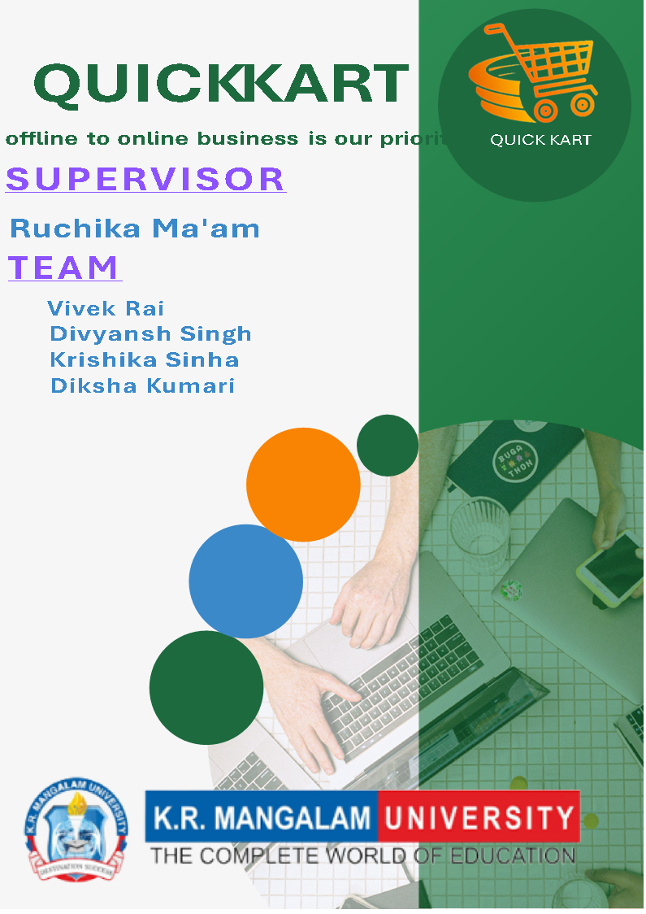
qUICK KART OFFLINE TO ONLINE BUSINESS IS OUR PRIORITY

Slide 2
INTRODUCTION:-
Quick Kart, a local offline store based in Sohna (Haryana), is taking the exciting step to expand its reach by moving online. This transition aims to provide convenience for customers who previously visited the physical store, allowing them to shop from the comfort of their homes. The online platform will feature a wide range of products available at Quick Kart, ensuring customers have access to all the items they love and need.

Slide 3

OBJECTIVES:-
Expand Customer Reach: Make Quick Kart’s products accessible to customers beyond Sohna, increasing the customer base.
Enhance Convenience: Provide customers with the ability to shop anytime, anywhere, offering a seamless online shopping experience.
Boost Sales & Growth: Increase revenue by tapping into the growing e-commerce market and scaling operations.
Improve Customer Engagement: Offer personalized services, promotions, and direct communication to strengthen customer relationships.

Slide 4
IMPORTANCE:-
Convenience & Accessibility: Quick Kart’s online presence allows customers to shop easily from anywhere, anytime, providing greater convenience compared to the offline store.
Business Growth: Going online expands Quick Kart’s reach beyond Sohna, opening doors to new customers and markets, leading to increased sales opportunities.
Customer Engagement: The online platform enables Quick Kart to interact with customers through personalized offers, promotions, and better communication, improving customer satisfaction and loyalty.

Slide 5
PROBLEM:-
Logistics & Delivery: Managing delivery logistics efficiently could be tricky, especially if customer orders grow rapidly. Ensuring timely delivery while maintaining product quality is critical.
Competition: The online market is competitive, with many established e-commerce platforms. Quick Kart will need to find ways to stand out, whether through pricing, unique products, or exceptional customer service.
Technical Setup and Maintenance: Establishing and maintaining a functional, secure, and user-friendly website or app can be complex and may require technical expertise.
Logistics and Delivery Issues: Efficiently managing product inventory, packaging, and timely delivery can become more complicated as the customer base expands beyond local reach.

Slide 6

Customer Trust and Security: Ensuring that customers feel secure shopping online, with safe payment systems and privacy protections, is crucial. Building trust can take time.
Increased Competition: The online market is crowded with many competitors. Quick Kart will need to differentiate itself with unique products, competitive pricing, and exceptional service.
Digital Marketing: Reaching new customers through online marketing (SEO, social media, ads) requires investment in strategies and understanding the digital landscape.
Adaptation of Traditional Business Practices: The shift may require a change in business operations, such as handling customer inquiries online or adapting to new inventory systems, which can take time to master.

Slide 7
METHODOLOGY:-
1. Product Selection
Browse and Search: Customers can browse categories or search for specific products.
Add to Cart: Once a product is found, users can add it to their shopping cart. This action should display a confirmation message (e.g., "Added to Cart").
2. After Purchase
Tracking: Provide order tracking information once the items are shipped.

Slide 8
3. Cart Management
View Cart: Users can view the contents of their cart by clicking on the cart icon, which should display the items added, including quantity, size, color, price, and a subtotal.
Edit Cart:
Change item quantity (e.g., increase or decrease).
Remove items from the cart.
Update prices automatically when changes are made.
Apply Coupons or Discounts: Provide an option to enter promo codes or discount coupons before checkout.

Slide 9
4. Checkout Process
Guest Checkout / Account Login: Allow customers to either log in or proceed as guests for a quicker checkout.
Shipping Information: Collect shipping details (name, address, phone number, etc.).
Shipping Method Selection: Offer different delivery options. it will say fast or slow delivery.
Payment Information: Provide secure payment gateways like—UPI, COD
Order Review: Display a final order summary (items, shipping details, total price).

Slide 10
5. Security Features
SSL Encryption: all personal and payment data is encrypted and not share with anyone.
Payment Gateway: don’t worry we use all Indian trusted payment method.
6.Additional Features
Wishlist: Allow users to save items to a wishlist for later purchase.
Real-time Stock Updates: Ensure cart reflects accurate inventory in real-time to avoid overselling.

Slide 11
OUTCOMES:-
Higher conversions and completed purchases.
Increased sales through upselling and repeat customers.
Improved user experience with easy navigation and checkout.
Customer trust through secure payments and clear communication.
Operational efficiency with streamlined processes.
Valuable insights for better marketing and inventors.

Slide 12
APPLICATIONS:-
E-commerce Platforms: It’s essential for online stores to allow customers to select, manage, and buy products.
Subscription Services: For managing recurring payments or membership sign-ups.
Digital Goods: Used for buying software, e-books, or online courses.
Marketplaces: Multi-seller platforms use it for buyers to add and purchase items from different sellers.
Mobile Apps: Shopping carts are integrated into retail apps for a smooth mobile shopping experience.

Slide 13
CHALLENGES AND LIMITATIONS:-
Security: Protecting customer data is crucial any breach can harm trust.
Tech Glitches: Bugs like wrong pricing or stock updates can frustrate buyers.
Payment Issues: Not all customers use the same payment methods, which can limit flexibility.
Mobile Compatibility: Ensuring the cart works smoothly on all devices can be tough.
Inventory Syncing: Keeping stock accurate in real-time to avoid overselling is challenging.

Slide 14
CONCLUSION:-
In conclusion, an effective online shopping cart system is key to providing a smooth shopping experience, boosting conversions, and increasing sales. However, challenges like cart abandonment, security risks, and tech issues must be carefully managed. By focusing on simplifying the user experience, offering secure payment options, and optimizing for mobile, businesses can overcome these obstacles. With constant improvements and attention to customer needs, the shopping cart process can drive long-term success and customer loyalty.

Slide 15
REFERENCE:-
Amazon: As one of the world’s largest e-commerce platforms, Amazon offers a robust shopping cart system with features like personalized recommendations, seamless checkout, and secure payment options.
Flipkart: A leading Indian e-commerce site, Flipkart’s cart system focuses on easy product management, various payment methods, and fast delivery options, ensuring a smooth shopping experience for its users.

Slide 16
QUESTION AND ANSWER:-
Q: What is Quick Kart? A: Quick Kart is an e-commerce platform that allows users to easily browse, add products to their shopping cart, and complete purchases in a simple, fast process.
Q: How does Quick Kart improve the shopping experience? A: Quick Kart streamlines the entire shopping process, from adding products to the cart to fast checkout, reducing friction and making the experience smoother for customers.
Q: Can I modify my cart in Quick Kart? A: Yes, you can easily adjust the quantity of items, remove products, or update preferences directly from your shopping cart.

Slide 17
Q: Does Quick Kart offer guest checkout? A: Yes, Quick Kart allows guest checkout, so you don’t need to create an account to complete your purchase.
Q: What payment methods does Quick Kart accept? A: Quick Kart supports various payment methods, including credit/debit cards, PayPal, and mobile payment options for convenience.
Q: Can I apply discounts or promo codes on Quick Kart? A: Yes, Quick Kart allows users to apply promo codes or discounts at checkout to receive special offers or savings.
Q: How secure is the payment process on Quick Kart? A: Quick Kart ensures secure payment transactions by using SSL encryption and trusted payment gateways, protecting your personal and payment information.

Slide 18
Q: How do I track my order on Quick Kart? A: After placing an order, Quick Kart provides tracking information to let you monitor your shipment’s status in real-time.
Q: What happens if an item is out of stock on Quick Kart? A: Quick Kart updates the availability status in real-time. If an item is out of stock, you’ll be notified, and you can either wait for restocking or choose an alternative.
Q: Does Quick Kart offer any customer support? A: Yes, Quick Kart provides customer support via chat, email, and phone to assist with any issues during your shopping experience

Slide 19
Thank you

